Slide 1
Offline English Character Recognition

Slide 2
Problem Definition
Offline English Character Recognition is a research area in the field of pattern recognition and image processing
It deals with extracting and recognizing handwritten characters or machine text from scanned images
It enables a person to write something on a piece of paper, convert it into an image and then into text

Slide 3
Motivation
It enables automation of processes and helps improve the man-machine interface
Cost-effective and speedy
Helps to free acres of storage space by transforming all paper documents to be stored on a single machine
Searching for particular files or documents becomes very easy when they are converted and stored in electronic form

Slide 4
Neural Networks (NN)
A NN is defined as a computing architecture that consists of a massively parallel interconnection of adaptive "neural" processors.
Because of its parallel nature, it can perform computations at a higher rate compared to the classical techniques
Because of its adaptive nature, it can adapt to changes in the data and learn the characteristics of input signal

Slide 5
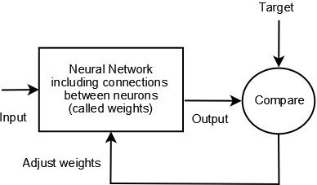
Working of a NN
A neural network uniquely learns the properties that differentiate training images
It then looks for similar properties in the target image to be identified

Slide 6
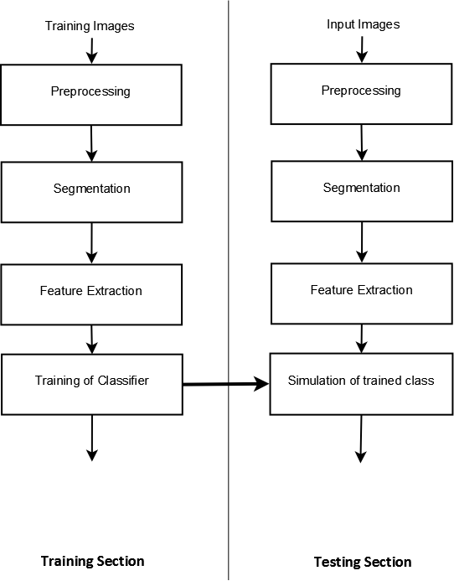
Stages in a NN algorithm

Slide 7
IMPLEMENTATION
(Neural networks based algorithms)

Slide 8
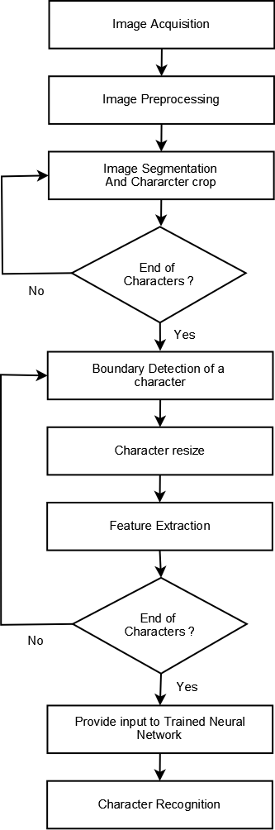
Proposed Algorithm For Training the Neural Network

Slide 9
(1) Image Acquisition
In this step, we acquire input images for training the neural network
The input image can contain handwritten or machine text in RGB or grayscale format

Slide 10
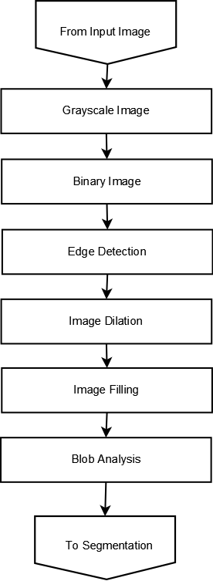
(2) Image Pre-processing

Slide 11
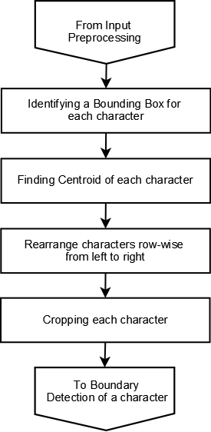
(3) Image Segmentation and Character crop

Slide 12
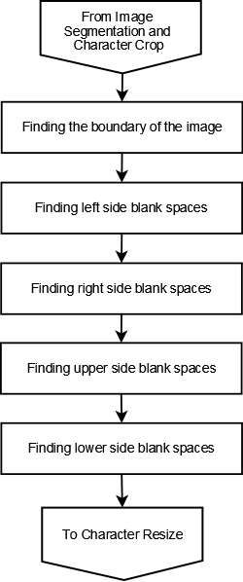
(4) Boundary Detection of a Character

Slide 13
(5) Character Resize
The cropped character images obtained from the previous step are of varying sizes as it depends on the size and shape of the characters
Hence, it becomes necessary to resize these images into some standard size for ease of processing
In this step, we resize each cropped character image into a 70x50 image.
This resized image is then fed as input for feature extraction.

Slide 14
(6) Feature Extraction
We divide the 70x50 character image obtained from the previous step into multiple 10x10 matrices starting from left. Thus, we obtain 5 such smaller matrices of size 10x10 from one row and we have 7 such rows. Thus, we obtain a total of 5*7=35 smaller matrices of size 10x10.
We convert each 5x7 character representation into a single 35x1 vector. For this, we take the sum of all the elements present in the 1st smaller matrix of size 10x10. This gives us 1st element of our 35x1 vector. Using the same procedure, we get all the 35 elements of the vector.
This gives us the character representation in vector form. The specialty of this vector is that this vector is unique for the character it represents. We repeat this procedure for all the characters in the training data. Thus we get an input matrix for training neural network.

Slide 15
(7) Train the NN
We propose to perform Offline English character recognition using 3 different architectures of Neural Networks:
Feedforward Backpropagation Neural Network (FFBPNN)
Elman Backpropagation Neural Network (EBPNN)
Fitting Neural Network (FNN)

Slide 16
Techniques for training the NN
Using an Identity matrix:
In this technique, we use an identity matrix as a target matrix for training the neural network
We consider 62 different characters in the training state and hence, we use an identity matrix of order 62x62
Each diagonal element in the matrix is 1 representing separate characters
Thus, there are 62 such neurons in the output layer of the neural network that can be fired
Hence, the neural network can be trained to fire only one specific neuron when a particular character is fed to the input layer of the neural network

Slide 17
Techniques for training the NN (Contd.)
2. Using ASCII values:
In this technique, we use ASCII values of characters as a target matrix for training the neural network
ASCII values are converted into binary format and stored into the target matrix
Each ASCII value needs 7 bits for its binary representation and there are total of 62 different characters
Therefore, we have a target matrix of size 7x62

Slide 18
(8) Simulate the Neural Network
Once the neural network is trained, we simulate it to check the efficiency of the output it produces
We use a small part of the data from the training dataset to simulate the trained neural network

Slide 19
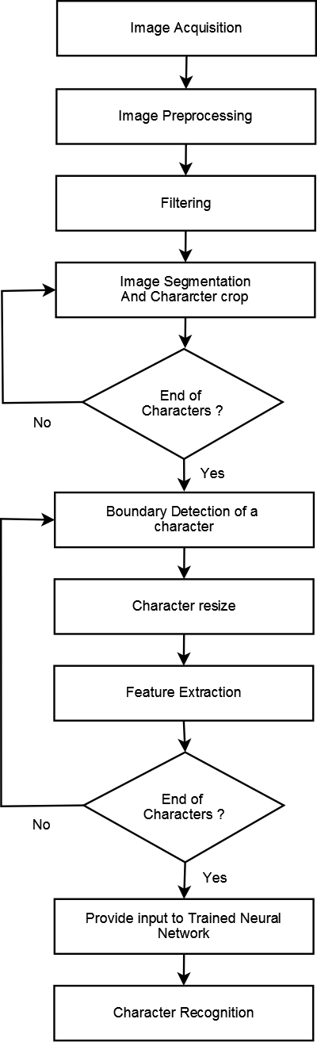
Proposed Algorithm For Character Recognition

Slide 20
RESULTS

Slide 21
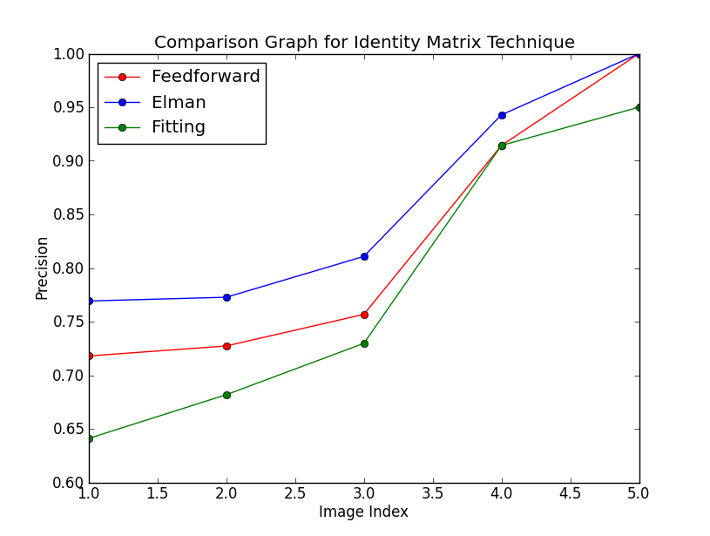
Comparison Graph (Identity Matrix)

Slide 22
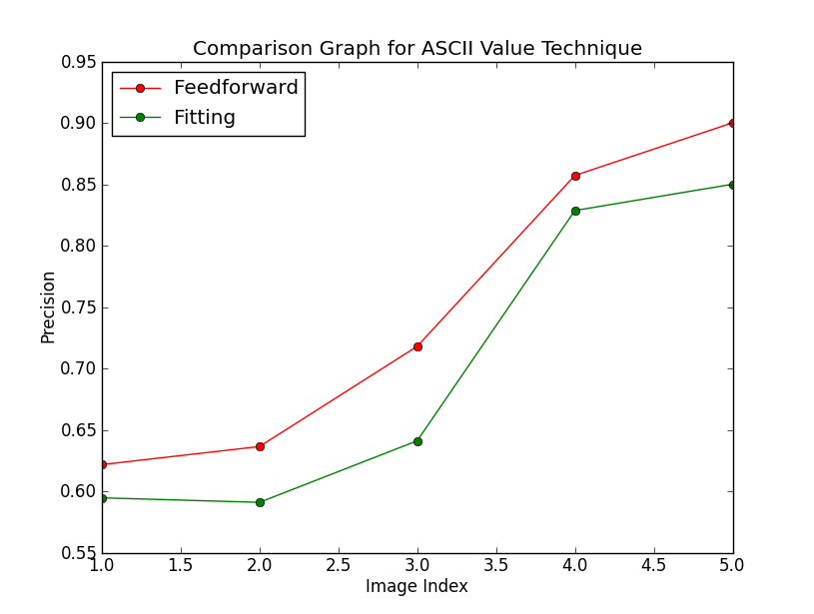
Comparison Graph (ASCII Values)

Slide 23
Conclusion
'Identity Matrix' technique performed better than 'ASCII' technique
Elman Backpropagation network performed best when used with the 'Identity Matrix' technique
Feedforward Backpropagation network performed best when used with 'ASCII value' technique

Slide 24
Applications
Document processing
Postal services like address recognition
Text to speech converters
Security applications
Bank processing

Slide 25
FUTURE SCOPE
Initialize and train again for better accuracy
Increase hidden neurons
Try different training function
Use Eigenvalues
Implement ASCII value technique using Elman Backpropagation network
Use additional training data

Slide 26
PROJECT GROUP
Aniket Ghag (091080028)
Jivitesh Poojary (091080065)
Sanket Malpure (091080042)
Thyagarajan R. (091080011)

Slide 27
THANK YOU !

